Slide 1
Bitminers
Bitcoin Mining
Alan Belyea
Ding Zhong
Marcia Sahaya Louis
Priya Baskaran
Tony Ye

Slide 2
Objectives and Goals
Objective:
•Design an FPGA capable of mining bitcoins with high performance
-Correct interfacing with bitcoin software
Goals:
•High speedup compared to video card and CPU based mining
-Pipelining, parallel execution
•Small area -> higher performance from higher parallelization

Slide 3
What makes our project interesting?
Heavy focus on performance and optimization
Goal: Maximize the number of hashes per second
Make critical path as short as possible
Allows for the potential to overclock
Reduce the number of flip flops/ slices used per hashing unit
Fit more hashing units on the board - n x speedup

Slide 4
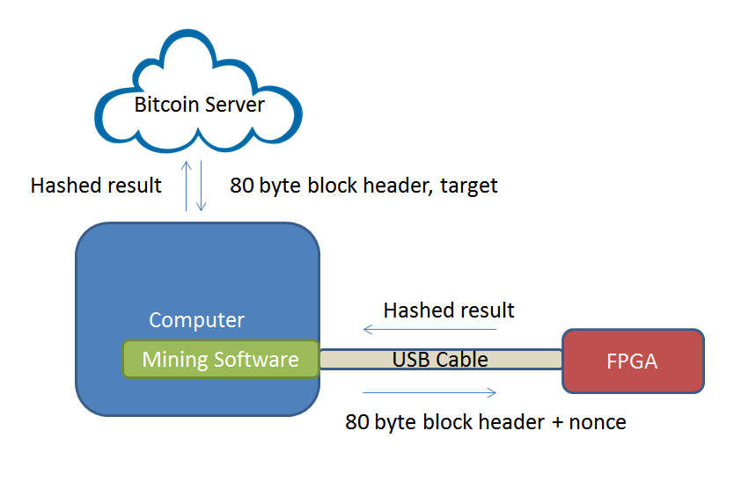
High Level Diagram

Slide 5
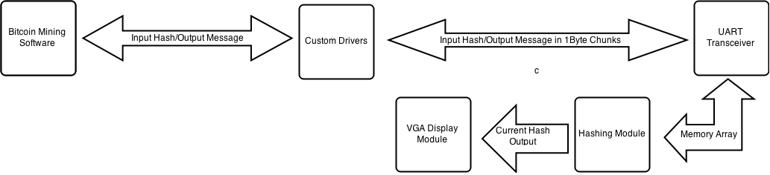
Low Level Diagram

Slide 6
Design Specification
Input: 640 bit message
Message is padded with 1 0000...0000 280 into a 1024 bit message
Message is partitioned into two 512 blocks
SHA-256 algorithm hashes the two blocks into a 256 bit output value
The 256 bit output is padded into 512 bits
The 512 bits is hashed into a 256 bit output (double hash)
If the 256 bit output is smaller than a target, a bitcoin is generated
Otherwise, increment the counter embedded in the 1024 bit message by 1, and try again
Output: If output hash < target, transmit the input message. Otherwise transmit nothing.
Constraints: Critical path for logic must be shorter than 10 ns (100 Mhz clock)

Slide 7
Hash Module
Input: 1024 bit message
Divided into 32 words - 2 blocks of 16 words
Generate a 256 bit hash value using the SHA-256 algorithm
Output: If output hash < target, transmit the input message. Otherwise transmit nothing.

Slide 8
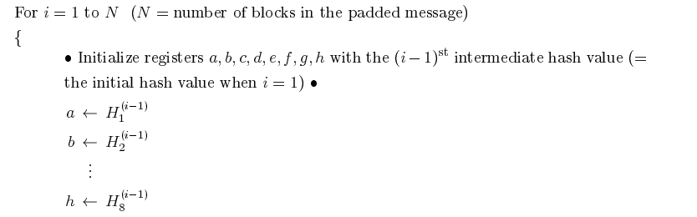
SHA-256 Algorithm – Initialize of registers

Slide 9
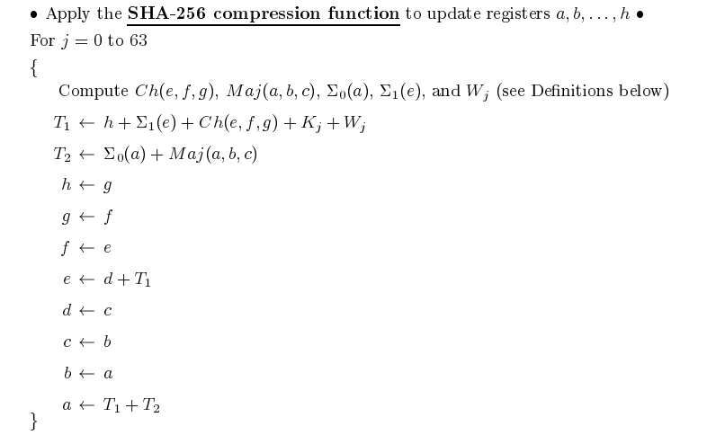
SHA -256 Algorithm- Compression block

Slide 10
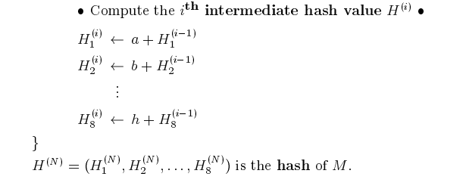
SHA- 256 Algorithm – Intermediate Hash

Slide 11
Data Flow in SHA-256 algorithm
Stage A
a
b
c
d
e
f
g
h
Stage B
S0
Maj
K
S1
Ch
W
Stage C
T2
T1
a
b
c
d
e
f
g
h

Slide 12
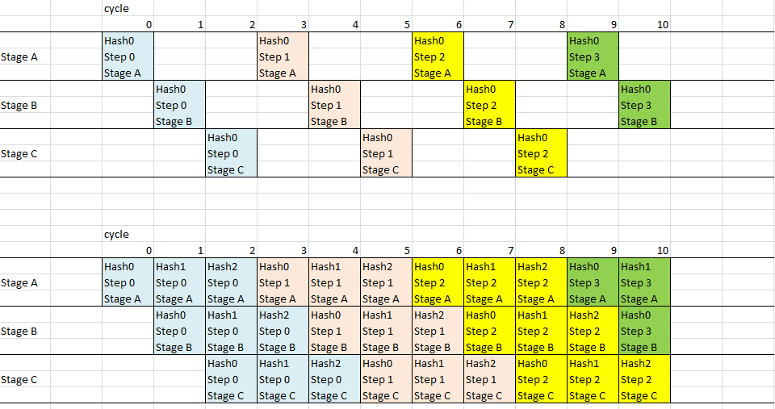
Optimizations
Initial idea: Separate one loop iteration into three cycles
Pipeline the data with 3 inputs, 3 phases

Slide 13
Issue:
Would require a-h, w registers to keep track of three sets of data
Large fan in, 3x increased area
a1 a2 a3
b1 b2 b3
c1 c2 c3
d1 d2 d3
e1 e2 e3
f1 f2 f3
g1 g2 g3
h1 h2 h3
Stage A
a
b
c
d
e
f
g
h
Stage B
S0
Maj
K
S1
Ch
W
w1 w2 w3
Stage C
T2
T1

Slide 14
Optimizations
Idea: Since logic is implemented in LUTs, combinatorial delay is extremely small even with complex logic
Reduce three cycle loop iteration into one cycle
Remove registers between each cycle
Pros: Decreased area, performance stays the same
Cons: Harder to debug timing issues

Slide 15
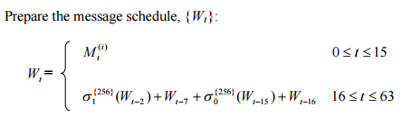
Optimizations
Each block contains 16 32-bit messages. 64 message values are generated by the following algorithm:
64 registers
σ
w(t)
+
σ
Initial setup: Create a message array [31:0] [63:0]

Slide 16
Optimizations
Idea: Only the last 16 previous values of W are needed to calculate the next value of W, all the older Ws are never reused
Use a shift register to generate the new values of W
σ
+
σ

Slide 17
Design Comparison
σ
64 registers
σ
+
w(t)
+
σ
σ
 | Initial Design | Shift Register
# Registers | 64 32 bit registers | 17 32 bit registers
Muxes | 4 64 input mux, 1 64 output mux | 0 muxes
Fan in/fan out | 1 fan in, 4 fan out | 1 fan in, 1.23 fan out

Slide 18
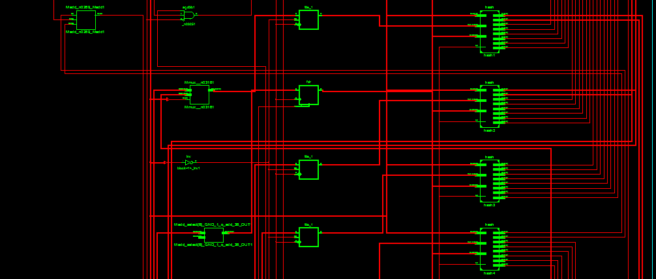
RTL Schematics - Super Module
Message signal
Hash Modules

Slide 19
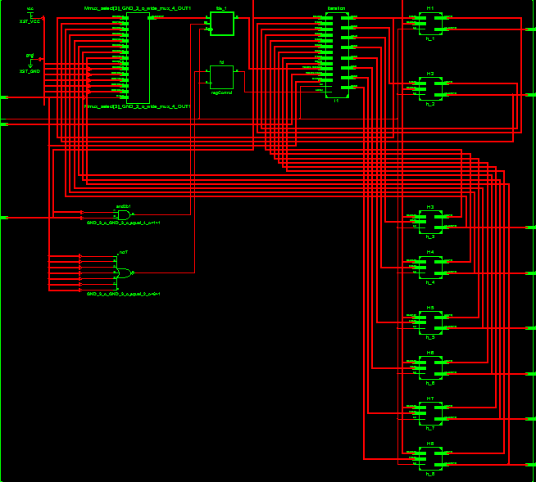
RTL Schematics
Hash Module
Message Memory
Iteration Module
H Registers

Slide 20
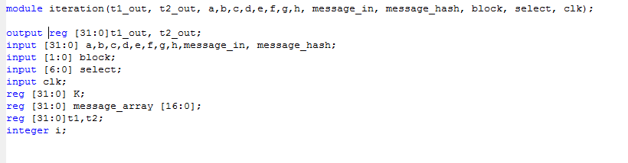
Verilog Example: Iteration.v
This module generates the T1 and T2 used for updating registers a and e.

Slide 21
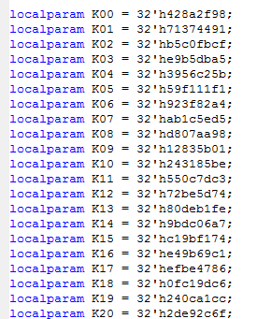
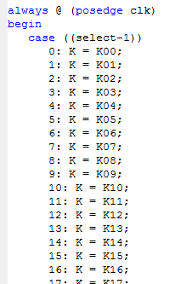
Verilog Example: Iteration.v
K values are defined with local param, to tie the values to Vdd and GND rather than use registers

Slide 22
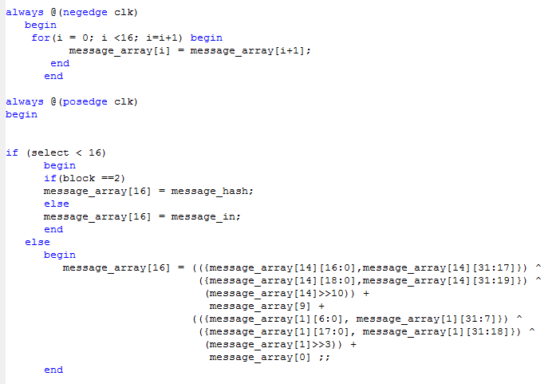
Verilog Example: Iteration.v
Shift Register Implementation for
Message input

Slide 23
Verilog Example: Iteration.v
All the logic is placed in one module so that the synthesis can reduce the logic into LUTs, and perform it in one cycle.
This reduces the critical path delay.

Slide 24
Successes, Failures
Success:
A double hash is generated correctly in simulation
We were able to fit 4 hashing modules on a Nexys 3 board
8 hashes per 196 cycles
100 Mhz clock
100 *10^6 (cycles/s) * (8 hashes/ 196 cycles) =
4.08 Mhashes/second

Slide 25
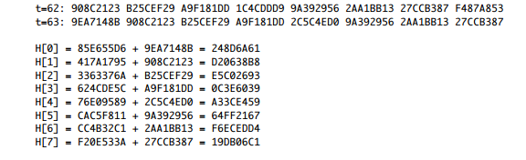
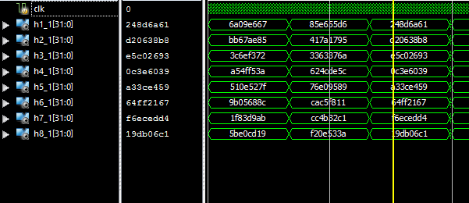
Successes, Failures
Simulation Results:

Slide 26
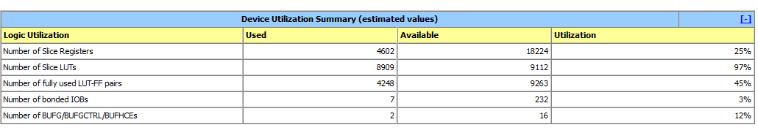
Successes, Failures
Failures:
Unable to fit more than 4 hashing cores on the board
Output on VGA does not match the output of simulation

Slide 27
To do:
Fix VGA output issues
Further optimize the double hash to reduce the clock cycles per two hashes from 195 cycles to 130 cycles.
Theoretical hash rate: 4.08 Mhashes/s => 6.15 Mhashes/s

Slide 28
UART data transmission
What is it:
Basic module that sends 1024 bits stored in an 8 bit wide memory array to the PC through the UART port.
Receives multiple 1 byte chunks of data and stores them in an array to pass to the hashing module
What works:
Successfully tested transmission of 1024 bits of data from FPGA-hyperterminal at 9600 bits/second
Receiver works in simulation, currently figuring out how to send data from HyperTerminal to FPGA
What needs to be done:
Test UART receiver on board
Integrate UART transceiver with custom drivers and hashing module
Extra: Increase bitrate

Slide 29
Open source Bitcoin miner
Set up open source bitcoin miner on Nexys3 board
-Baud rate for transmission and reception modules adjusted based on 100Mhz clock
-UART receives 64 bytes of data and transmits 4 bytes of data (Tested)
-Seven segment display shows all four digits with stability
-Fixed issues - led being dim and jumpy display
-Display 4 bytes of data at once ( useful for hardware debugging )
-Hash algorithm in the open source code has not been tested
-Integrate our own hash algorithm ( To be done )

Slide 30
Communicate with Bitcoin mining software
Serial Communication - Open source bitminer to Windows driver
-Necessary in order to connect to bitcoin mining software that communicates with the server
-Implement device driver using windows serial port programming in C
-Driver transmits and receives chunks of data at baud rate of 9600 bps to match fpga
-Tested the data transfers in both directions
Integrate driver code with bitcoin mining software - In progress

Slide 31
Successes, Failures
Successes:
Open source bitminer UART code works on Nexys3 board
Successful communication between Open source bitminer and Windows driver
Failures:
Not yet demonstrated the hash algorithm that is available in Open source bitminer
-This could serve as a baseline to compare performance

Slide 32
VGA and Displaying
How it works:
-640*480 screen splitted into 2400 8*16 boxes
-80*30 memory matrix corresponding to the display grids
-Data of both input & output hashes will be stored in matrix
-Content of grid retrieved by vsync coordinates
-RGB data determined by content and code book
Success:
more than enough space to display all data in hexadecimal
To do:
implement control on screen refresh rate

Slide 33
